Slide 1
Major Project
Defenses against adversarial images

Slide 2

MAJOR PROJECT PRESENTATION
DEFENSES AGAINST ADVERSARIAL IMAGES
Submitted in partial fulfillment of the requirements
for the award of the degree of
Bachelor of Technology
Computer Science and Engineering
Guide:
Ms. Shruti Ma’am
Submitted by:
Team - 7
HMR INSTITUTE OF TECHNOLOGY & MANAGEMENT
HAMIDPUR, DELHI-110036
Affiliated to
GURU GOBIND SINGH INDRAPRASTHA UNIVERSITY
Sector-16C Dwarka, Delhi-110075, India
2017-2021

Slide 3
The Team
1 . Deepak Kumar 006796502717
2 . Deepak Kumar Rai 00796502717
3 . Jnaneshwar 01096502717
4 . Manthan Singh 01396502717
Guided by:
Ms. Shruti Ma’am
Associate Professor
(Department of Computer Science and Engineering, HMRITM)

Slide 4
Contents
The Problem Statement
Objective
The Dataset
What is CNN?
Gradient Descent
Adversarial Machine Learning
Adversarial Attacks & Defenses
Result
Problems and Considerations of Defense
Future Scope
Bibliography
Links Related to Project

Slide 5
The Problem Statement
Using adversarial images, we can trick our Convolutional Neural Networks (CNNs) into making incorrect predictions. While, according to the human eye, adversarial images may look identical to their original counterparts, they contain small perturbations that cause our CNNs to make wildly incorrect predictions.
For example, imagine a deep neural network deployed to a self-driving car. Nefarious users could generate adversarial images, print them, and then apply them to the road, signs, overpasses, etc., which would result in the model thinking there were pedestrians, cars, or obstacles when there are, in fact, none! The result could be disastrous, including car accidents, injuries, and loss of life.

Slide 6
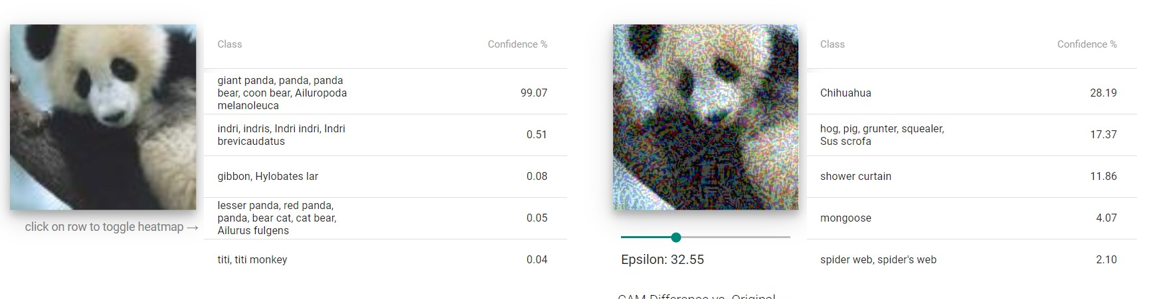
An Example

Slide 7
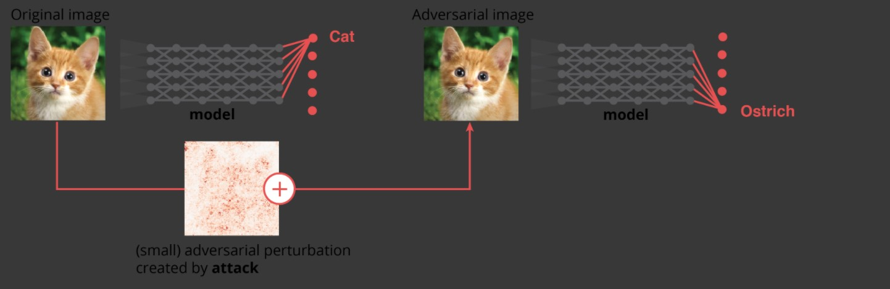
Another Example

Slide 8
OBJECTIVE
The objective of our project is to learn the concepts of a CNN model, Attacks on Deep Neural Networks and build a working model in order to defenses against Adversarial Images Attacks.
In this project, we will be implementing the Adversarial Defenses against a FGSM(Fast Gradient Sign Method) Attack using Keras and TensorFlow and other dependency packages of Python Programming Language. The image features will be extracted from the MNIST dataset.

Slide 9
Why does this matter?
Computer vision is used everywhere!
Facial Recognition
Self Driving Cars (change speed limit sign)
Biometric Recognition
Text Applications too! (Think CNNs for Sentiment Analysis or Text classification)
Ad-blockers can incorrectly classify ads
Spam Classifiers can incorrectly identify malicious mails

Slide 10
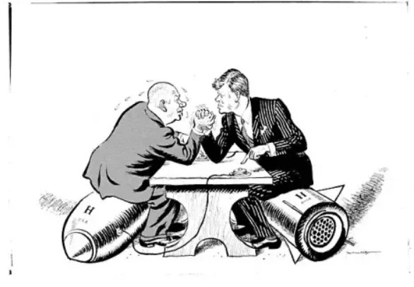
Adversarial images are an “arm race” and we need to defend against them
Defending against adversarial attacks has been and will continue to be an active research area. There is no “magic bullet” method that will make your model robust to adversarial attacks.

Slide 11
The Dataset
The MNIST database (Modified National Institute of Standards and Technology database) is a large database of handwritten digits that is commonly used for training various image processing systems. The database is also widely used for training and testing in the field of machine learning. It was created by "re-mixing" the samples from NIST's original datasets.
The MNIST database contains 60,000 training images and 10,000 testing images. Half of the training set and half of the test set were taken from NIST's training dataset, while the other half of the training set and the other half of the test set were taken from NIST's testing dataset.

Slide 12
WHAT IS CNN?
Convolutional Neural networks are specialized deep neural networks which can process the data that has input shape like a 2D matrix. Images are easily represented as a 2D matrix and CNN is very useful in working with images.
CNN is basically used for image classifications and identifying if an image is a bird, a plane or Superman, etc.
It scans images from left to right and top to bottom to pull out important features from the image and combines the feature to classify images. It can handle the images that have been translated, rotated, scaled and changes in perspective.

Slide 13
GRADIENT DESCENT
Gradient descent is an iterative optimization algorithm used in machine learning to minimize a loss function.
The loss function describes how well the model will perform given the current set of parameters (weights and biases) and gradient descent is used to find the best set of parameters. This is achieved by taking the partial derivative at a given point and then iteratively traversing the search space in the negative direction of the function gradient.

Slide 14
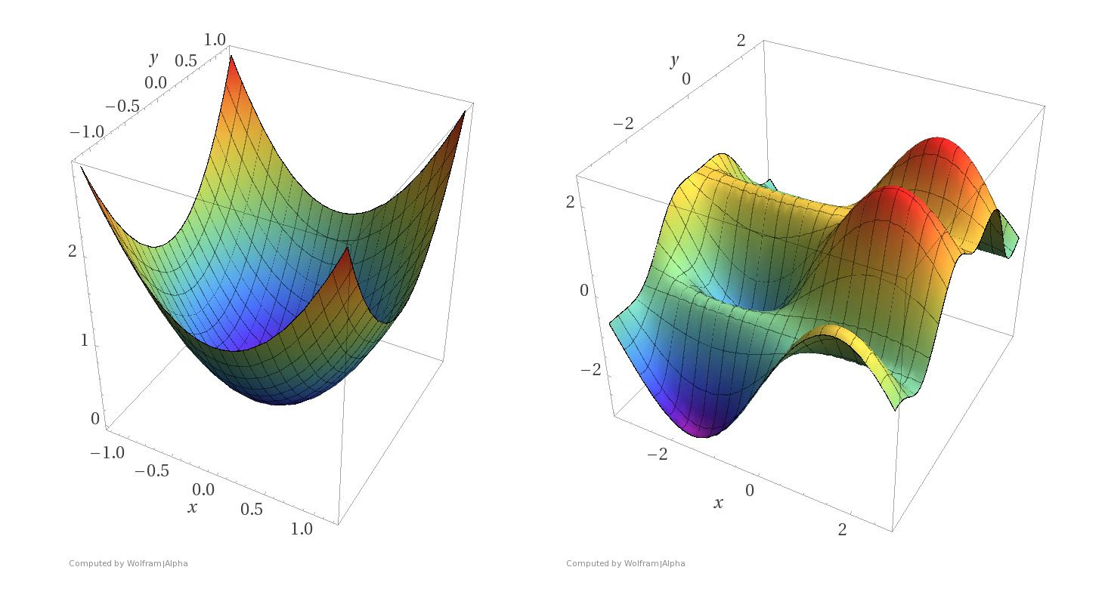
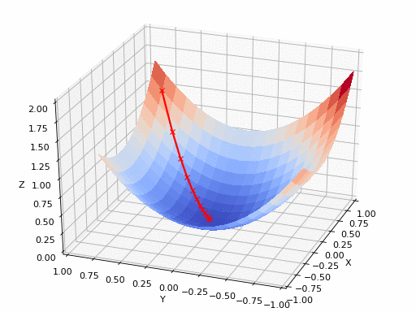
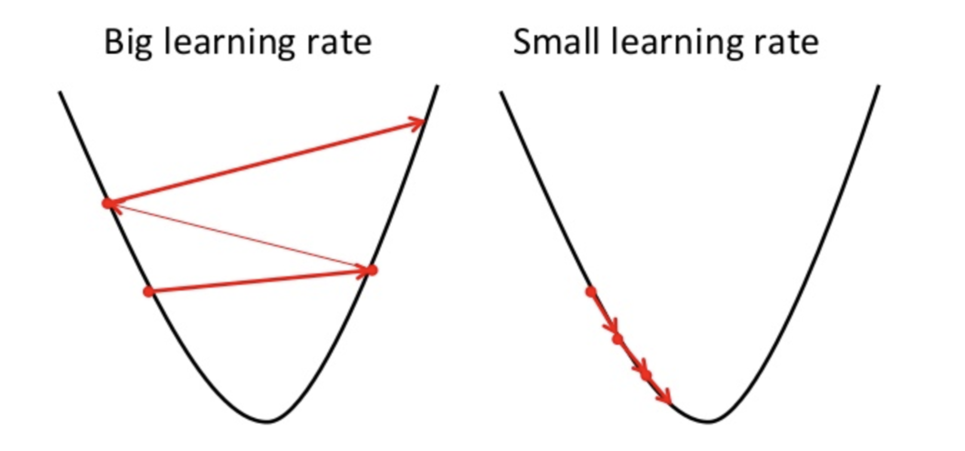

Slide 15
Adversarial Machine Learning
Adversarial machine learning is a machine learning technique that attempts to fool models by supplying deceptive input. The most common reason is to cause a malfunction in a machine learning model.
Most machine learning techniques were designed to work on specific problem sets in which the training and test data are generated from the same statistical distribution (IID). When those models are applied to the real world, adversaries may supply data that violates that statistical assumption. This data may be arranged to exploit specific vulnerabilities and compromise the results.

Slide 16
Major Type of Adversarial Attacks
1. Fast Gradient Sign Method(FGSM)
This technique adds noise (not random noise) whose direction is the same as the gradient of the cost function with respect to the data.
The noise is scaled by epsilon, which is usually constrained to be a small number via max norm.
The magnitude of gradient does not matter in this formula, but the direction (+/-).
FGSM can be implemented in Python in a few lines.

Slide 17
2. Backward Pass Differentiable Approximation(BPDA)
Attackers are very smart! They found a way to fool the FGSM.
In the game of security, both attacker and defender rely on gradient descent to learn. The gradient gives the defender information about how to improve the model; the same gradient tells the attacker how to trick the model!
Gradient masking occurs when the defender attempts to hide the gradient from the attacker, often by using a non-differentiable transform or technique like a decision tree.
If you can’t differentiate, there is no gradient for the attacker to use! A particular type of gradient masking, known as shattered gradients, makes the defense gradient either non-differentiable, non-existent, or just wrong.
This defense approach worked at first but was eventually defeated by an attack known as Backward Pass Differentiable Approximation (BPDA)

Slide 18
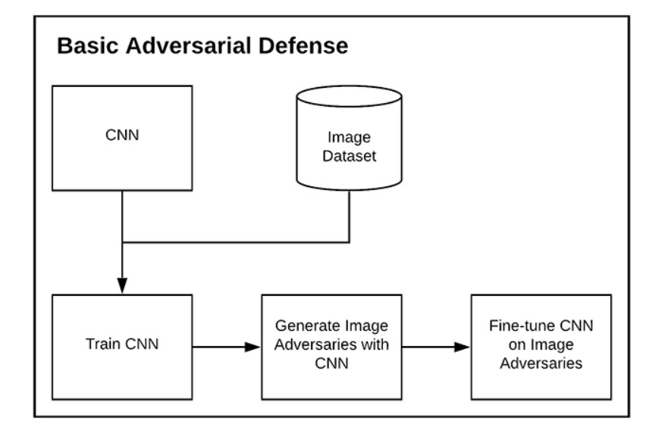
How Can You Defend Against Adversarial Image Attacks?

Slide 19
Ways To Defend Against Adversarial Attacks
Training our model on a given dataset, generating a set of adversarial images, and then fine-tuning the model on the adversarial images
Generating mixed batches of both the original training images and adversarial images, followed by fine-tuning our neural network on these mixed batches

Slide 20
Major Defenses Are?
ADVERSARIAL TRAINING
THE BARRAGE OF RANDOM TRANSFORM(BaRT)

Slide 21
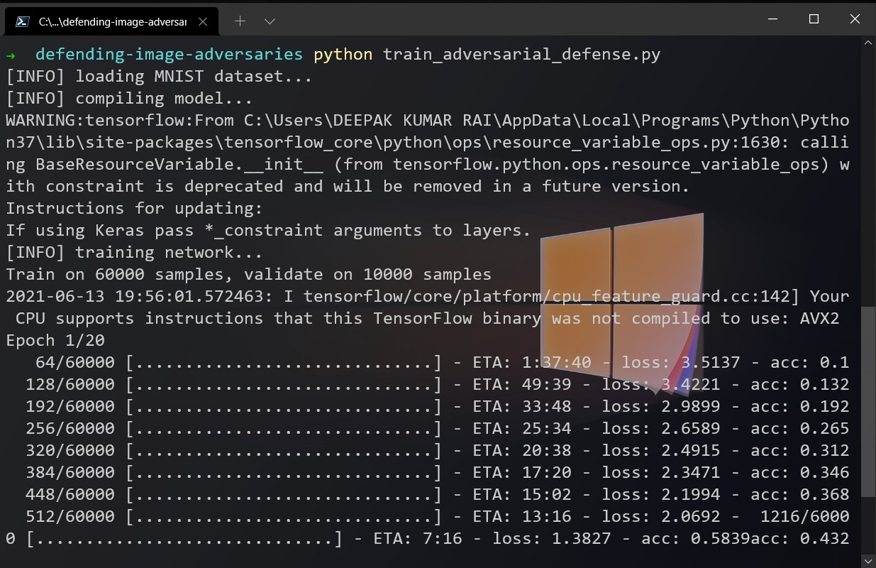
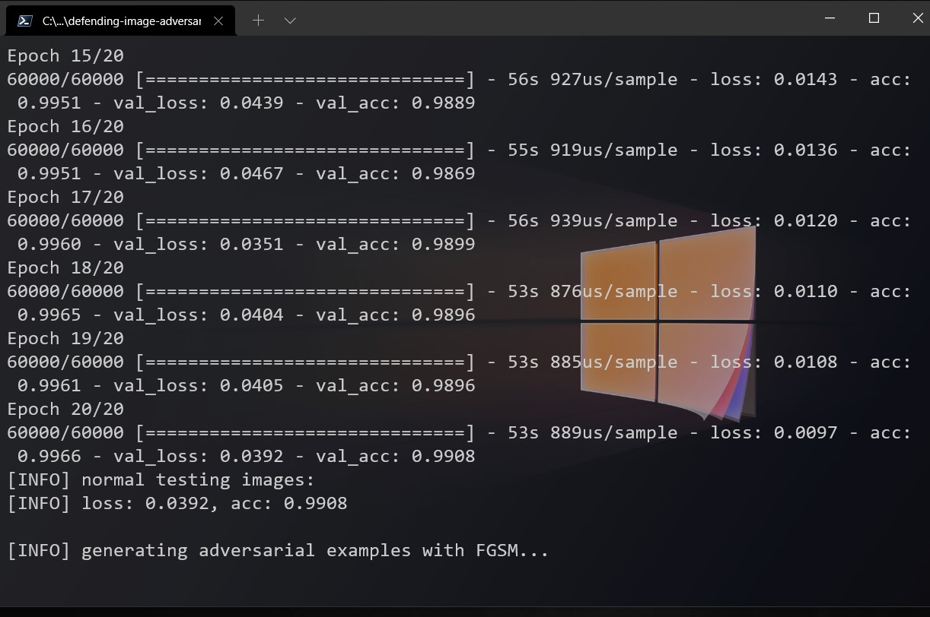
RESULT

Slide 22
RESULT
Here, you can see that we have trained our CNN on the MNIST dataset for 20 epochs. We’ve obtained 99.08% accuracy on the training set and 98.92% accuracy on our testing set, implying that our CNN is doing a good job making digit predictions.
Our model can make correct predictions on the original, non-perturbed images from the MNIST dataset.
We can also make accurate predictions on the generated adversarial images (meaning that we’ve successfully defended against them).

Slide 23
Problem and Considerations with Adversarial Image Defenses
Both of the adversarial image defense methods mentioned in the previous section are dependent on:
The model architecture and weights used to generate the adversarial examples
The optimizer used to generate them
These training schemes might not generalize well if we simply create an adversarial image with a different model (potentially a more complex one).Additionally, if we train only on adversarial images then the model might not perform well on the regular images. This phenomenon is often referred to as catastrophic forgetting, and in the context of adversarial defense, means that the model has “forgotten” what a real image looks like.

Slide 24
Summary
In this Project, we learned how to defend against adversarial image attacks using Keras and TensorFlow. Our adversarial image defense worked by:
1. Training a CNN on our dataset
2. Generating a set of adversarial images using the trained model
3. Fine-tuning our model on the adversarial images
The result is a model that is both:
1. Accurate on the original testing images
2. Capable of correctly classifying the adversarial images as well
The fine-tuning approach to adversarial image defense is essentially the most basic adversarial defense.

Slide 25
Future Scopes
This approach is useful whenever Image classifications performed , in order to protect it from Adversarial Image Attacks.
Definitely , being a deep neural network it takes a significant amount of time , but this can be eliminated by using GPU’s and Hyper Fine-tuning the network according to the desired situation.

Slide 26
Bibliography
https://arxiv.org/pdf/1412.6572.pdf
https://arxiv.org/pdf/1803.05123.pdf
https://arxiv.org/pdf/2006.14536.pdf
https://www.pyimagesearch.com/2021/03/08/defending-against-adversarial-image-attacks-with-keras-and-tensorflow/
https://medium.com/analytics-vidhya/implementing-adversarial-attacks-and-defenses-in-keras-tensorflow-2-0-cab6120c5715
https://arxiv.org/pdf/1905.02175.pdf

Slide 27
Links Related to Project
GitHub : https://github.com/imdeepak27/Major-Project-2021---Defenses-Against-Adversarial-Images
Google Colab Notebook : https://colab.research.google.com/drive/1wT9Z2OB30g5uOT5ojwwi55YsNqIUKkMx?usp=sharing

Slide 28
Thank you
🙂

